Slide 1
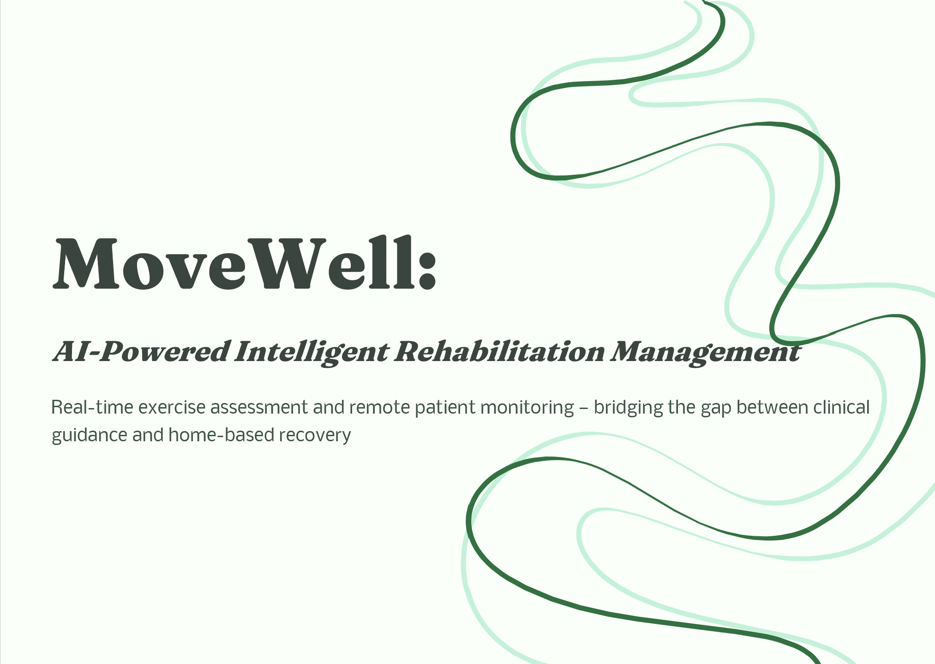




MoveWell:
AI-Powered Intelligent Rehabilitation Management
Real-time exercise assessment and remote patient monitoring — bridging the gap between clinical guidance and home-based recovery

Slide 2


The Problem We're Solving
Current Challenges
Patients perform exercises incorrectly at home with no real-time correction
Existing apps count repetitions but ignore movement quality
Physiotherapists cannot monitor patients between visits
Manual follow-ups reduce treatment efficiency and adherence
Objective: Detect exercises in real time, validate posture, provide instant feedback, and enable remote rehabilitation through integrated portals.

Slide 3
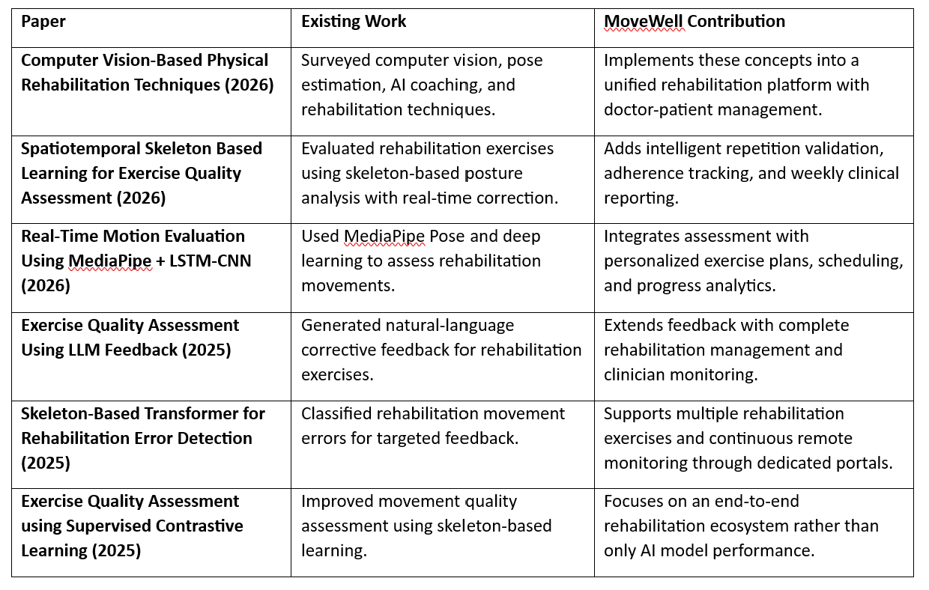
Research Landscape & Gap

Slide 4
Proposed Methodology
MoveWell's pipeline flows from clinician-assigned plans through real-time AI assessment to structured reporting and review.
Doctor Portal
Patient Dashboard
MediaPipe Pose
Assign exercise plan and schedule
Live camera capture
Estimation and skeleton extraction
Joint Angle Analysis
Feedback & Reps
Reporting & Review
Exercise quality assessment
Correct posture → count rep; Incorrect → instant feedback
Store metrics, generate weekly reports, doctor review and appointment
Only correctly performed repetitions are counted, ensuring quality over quantity in every rehabilitation session.

Slide 5
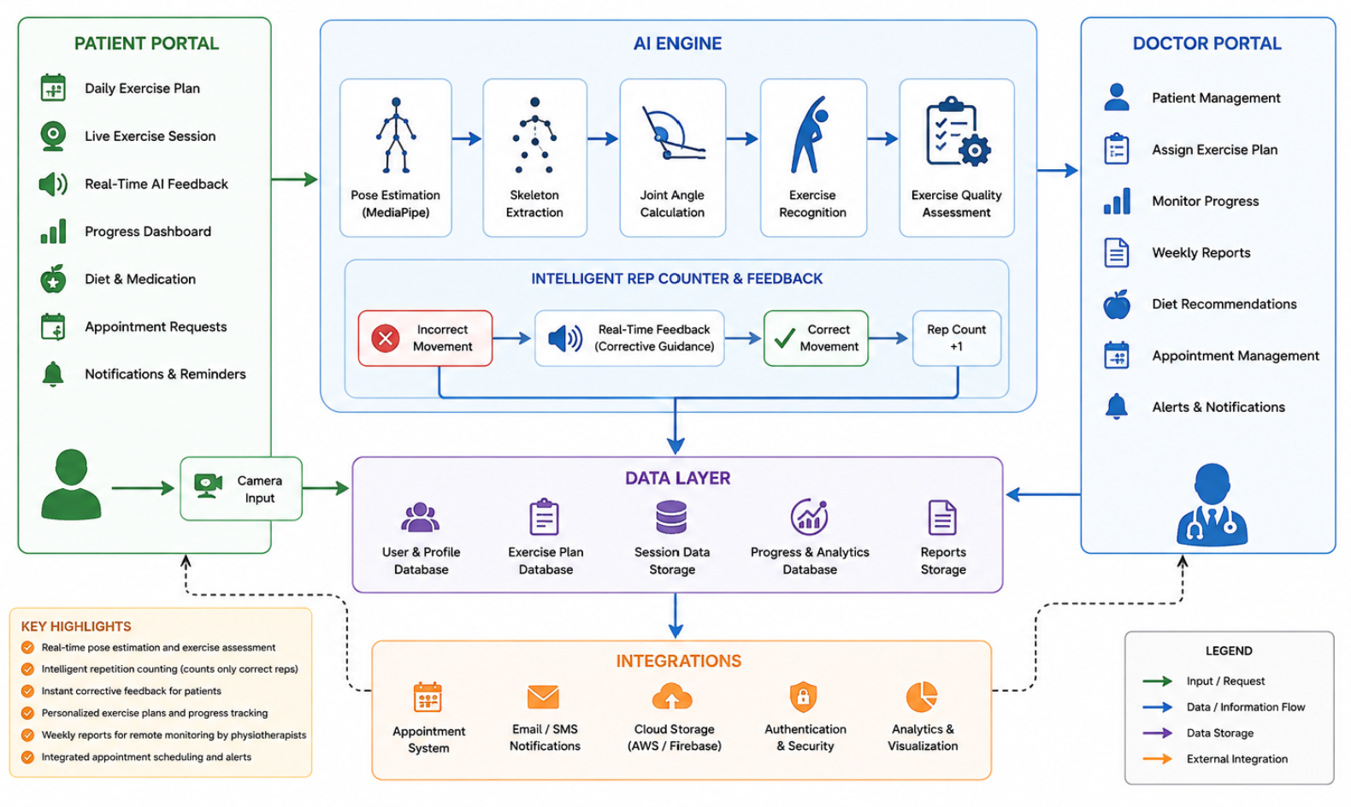
System Architecture
Doctor Portal
AI Engine
Patient Portal
Assign plans, set schedules, monitor reports, manage appointments
Pose estimation, joint angle calculation, exercise recognition, real-time feedback
Daily schedule, live AI-guided exercise, progress tracking, doctor recommendations

Slide 6

Expected Outcomes
Patients
Physiotherapists
Correct rehabilitation exercises
Faster recovery
Better adherence
Instant AI guidance
Remote patient monitoring
Weekly rehabilitation reports
Reduced manual follow-ups
Better clinical decisions
Healthcare System
Improved rehabilitation outcomes
Scalable home-based physiotherapy
Reduced unnecessary hospital visits

Slide 7
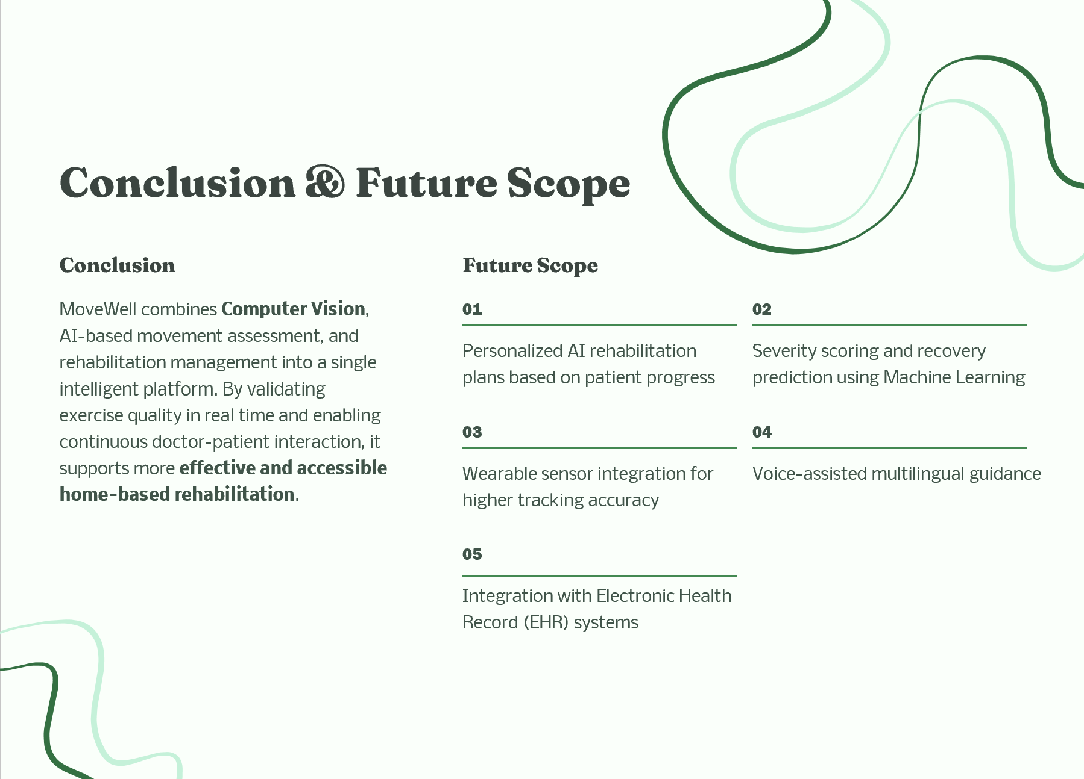




Conclusion & Future Scope
Conclusion
Future Scope
MoveWell combines Computer Vision, AI-based movement assessment, and rehabilitation management into a single intelligent platform. By validating exercise quality in real time and enabling continuous doctor-patient interaction, it supports more effective and accessible home-based rehabilitation.
01
02
Personalized AI rehabilitation plans based on patient progress
Severity scoring and recovery prediction using Machine Learning
03
04
Wearable sensor integration for higher tracking accuracy
Voice-assisted multilingual guidance
05
Integration with Electronic Health
Record (EHR) systems

